Slide 1
Trisomy 21
Anni 240321

Slide 2
ANOVA_Comparison 1. Trisomy 21 vs Trisomy_AOAA only flux forms
Anova is not best here for getting significant values. Not used in general here, but it give nice plots for visualizing

Slide 3
Heatmap – ANOVA (lot of varation between samples) → we can do flux ratio to fed 13C6-Glucose. You will then have less samples to sample variation.
PPP shunt down in Trisomy
Glycolysis up in Trisomy, more with AOAA
TCA flux up in AOAA in Trisomy
Might need to remove succinate since for some reason it looks
there are techical issues in controls at least

Slide 4
t-test raw p-value <0.05
 | f.value | p.value | -log10(p) | FDR | Fisher's LSD
Dihydroxyacetone Phosphate (DHAP)+3 | 9.0474 | 0.00023805 | 3.6233 | 0.017853 | Healthy_2_AOAA - Healthy_1_Control; Trisomy-21_1_Control - Healthy_1_Control; Trisomy-21_2_AOAA - Healthy_1_Control; Trisomy-21_1_Control - Healthy_2_AOAA
phosphoserine+3 | 7.5824 | 0.00073105 | 3.1361 | 0.027415 | Trisomy-21_2_AOAA - Healthy_1_Control; Trisomy-21_2_AOAA - Healthy_2_AOAA; Trisomy-21_2_AOAA - Trisomy-21_1_Control
Succinic acid+2 | 6.8501 | 0.0013252 | 2.8777 | 0.033131 | Healthy_2_AOAA - Healthy_1_Control; Trisomy-21_1_Control - Healthy_1_Control; Trisomy-21_2_AOAA - Healthy_1_Control
Glycerol 3-phosphate pathway down in AOAA?
DHAP down, but could be due to glycolysisi as well
- Glycerol 3 phosphate down as well in data!

Slide 5
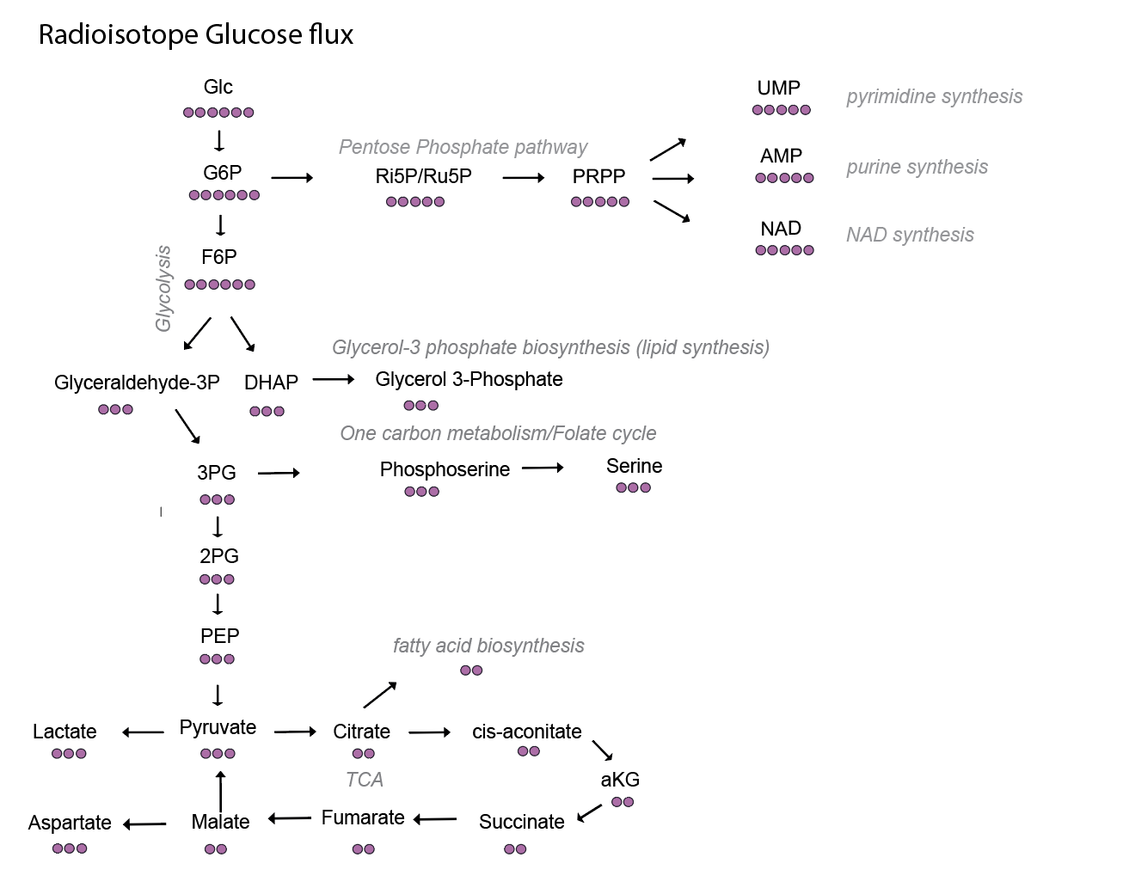
Glycolysis is higher in Trisomy with AOAA and results in TCA, not lactate:
AOAA
Either pyruvate entry to mito via MPC or
PDH complex is more active
Would be good if you make graphs for all of these in excell

Slide 6
PPP shunt same but endpoint changed: decreased AMP, ADP synthesis in Trisomy (not significant p-values for all), only shight increase with AOAA for ADP and NAD
AOAA
?
Show also ATP+5 Not significant but same trend
Total levels are needed for these
Only pyrimidine affected

Slide 7
TCA: AOAA increased TCA flux in Trisomy! (in ANOVA not significant, since using FDR values)
AOAA

Slide 8
AOAA reverts Glycerol 3-phosphate synthesis increased in Trisomy (Triglycerides or glycerol3 phosphate shuttle?) – significant!
AOAA
Not sure if you should follow at all
Phosphoserine since no changes
in serine

